Slide 1


Crop and Fertilizer Recommendation System Using Machine Learning
K Mohan Vamsi kumar Reddy

Slide 2

Learning Objectives
Understand how machine learning can be applied in precision agriculture.
Learn data preprocessing, model training, and evaluation for classification problems.
Implement an end-to-end ML pipeline to predict crops and fertilizers.
Visualize data insights to understand correlations between agricultural parameters.
GOAL
Source :
www.freepik.com/

Slide 3
Tools and Technology used
Datasets:
Crop Data: Crop Recommendation Dataset
Fertilizer Data: Fertilizer Prediction Dataset
Image Assets: Freepik
Tools: Python, Scikit-learn, Pandas, Seaborn, Matplotlib
Models:
Crop Classifier using soil nutrients, temperature, humidity, pH, and rainfall.
Fertilizer Classifier using soil type, crop type, and moisture levels.

Slide 4
Methodology
Data Collection:
Used crop and fertilizer datasets with parameters like N, P, K, temperature, humidity, pH, rainfall, soil type, and moisture.
Data Preprocessing:
Handled missing values, encoded categorical variables (e.g., Soil Type, Crop Type), and cleaned the data.
Data Visualization:
Created correlation heatmaps, crop distribution charts, and confusion matrices to understand data patterns and model performance.
Model Development:
Trained two Random Forest Classifier models:
Crop Model using soil nutrients and weather features
Fertilizer Model using soil type, crop type, and nutrients
Model Evaluation:
Used accuracy score and confusion matrix to evaluate model performance. Both models achieved high accuracy on test data.
Real-Time Prediction:
Accepts user input (e.g., N, P, K, temperature, soil type)
Predicts the best Crop
Recommends the ideal Fertilizer

Slide 5
Problem Statement:
In agriculture, many farmers still rely on traditional knowledge or assumptions to decide which crop to cultivate and which fertilizer to use. This often results in poor crop yield, degradation of soil health, and inefficient use of resources. The absence of expert guidance or access to scientific analysis tools makes it difficult for farmers to make informed decisions. Moreover, climatic variations and soil diversity further complicate these choices. There is a growing need for a smart, data-driven system that can analyze environmental and soil parameters to provide accurate crop and fertilizer recommendations, ensuring sustainable and productive farming.

Slide 6
Solution:
Github Link: https://github.com/MohanVamsi03/Crop-and-Fertilizer-Recommendation-System-/blob/91942dd14a4152ba674401a800a8aa4b9bd56deb/crop_and_fertilizer_ml.ipynb
Collect Data:
Gathered crop and fertilizer datasets containing soil nutrients, weather conditions, soil types, and labels for crop/fertilizer.
Preprocess the Data:
Cleaned the datasets, handled missing values, and encoded categorical features (e.g., Soil Type, Crop Type).
Train Machine Learning Models:
Built two models using Random Forest Classifier:Crop prediction model based on soil and weather features.Fertilizer prediction model based on crop, soil type, and nutrients.
Take Real-Time User Input:
Accepts values such as N, P, K, temperature, humidity, pH, rainfall, moisture, and soil type.
Generate Recommendations:
Predicts the best crop to grow under given conditions.Recommends the most suitable fertilizer to support the crop and soil health.

Slide 7
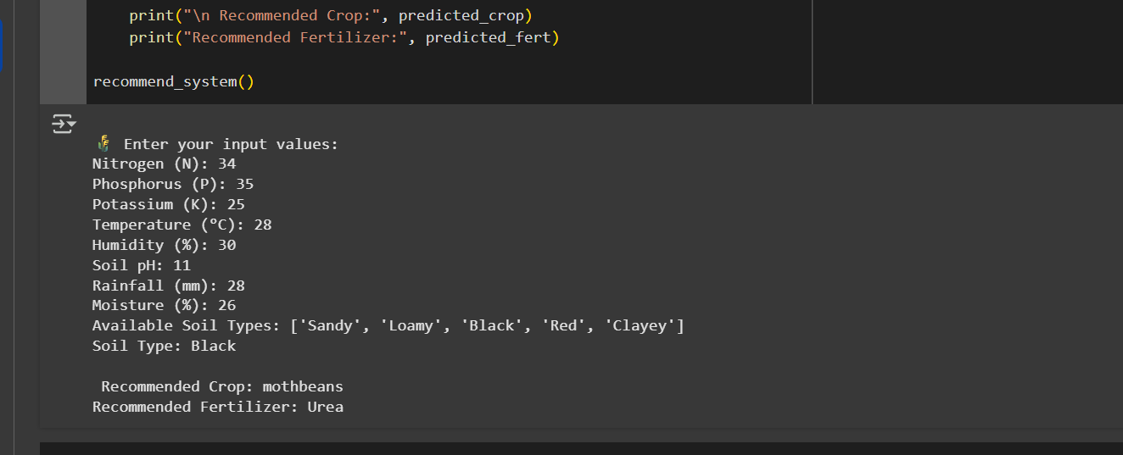
Screenshot of Output:

Slide 8
Conclusion:
The Crop and Fertilizer Recommendation System successfully demonstrates how machine learning can be applied to solve real-world agricultural problems. By analyzing soil nutrients, weather conditions, and soil type, the system provides accurate and reliable recommendations to farmers. This helps improve crop yield, optimize fertilizer use, and promote sustainable farming practices. The models achieved high accuracy and can be easily extended into mobile or web applications for broader accessibility. Overall, the project bridges the gap between technology and agriculture, empowering farmers with data-driven decisions and contributing to the development of smart farming solutions for the future.

